Slide 1
Uncertainty
Instructor: Dr. Wei Ding
CS 470/670 Artificial Intelligence

Slide 2
Uncertainty
What an agent should do when not all is crystal clear?
Let action A_{t} = leave for airport t minutes before flight
Will A_{t} get me there on time?
Problems:
partial observability (road state, other drivers' plans, etc.)
Hence a purely logical approach either
risks falsehood: “A₂₅ will get me there on time”, or
leads to conclusions that are too weak for decision making:
“A₂₅ will get me there on time if there's no accident on the bridge and it doesn't rain and my tires remain intact etc.”
noisy sensors (traffic reports)
uncertainty in action outcomes (flat tire, etc.)
immense complexity of modeling and predicting traffic
CS 470/670 Artificial Intelligence

Slide 3
Rational Decision
The right thing to do—the rational decision—therefore depends on both the relative importance of various goals and the likelihood that, and degree to which, they will be achieved.
CS 470/670 Artificial Intelligence

Slide 4

Methods for handling uncertainty
For example, diagnosis is a task that almost always involves uncertainty.
Try to write rules for dental diagnosis using first-order logic, so that we can see how the logical approach breaks down.
∀p Symptom(p, toothache) ⇒ Disease(p, Cavity)
This rule is wrong. Not all patients with toothaches have cavities. So we modify the rule
CS 470/670 Artificial Intelligence

Slide 5
∀p Symptom(p, toothache) ⇒ Disease(p, Cavity) ∨ Disease(p, GumDisease) ∨ Disease(p, Abscess)…
Unfortunately, in order to make the rule true, we have to add an almost unlimited list of possible causes.
CS 470/670 Artificial Intelligence

Slide 6
First-order logic does not work
Trying to use first-order logic to cope with an uncertainty domain may fail for three main reasons:
Laziness: It is too much work to list the complete set of antecedents or consequents needed to ensure an exceptionless rule and too hard to use such rules.
Theoretical ignorance: For example, Medical Science has no complete theory for the domain.
Practical ignorance: Even if we know all the rules, we might be uncertain about a particular patient because not all the necessary tests have been or can be run.
CS 470/670 Artificial Intelligence

Slide 7
Probability theory
The agent’s knowledge can at best provided only a degree of belief in the relevant sentences.
Our main tool for dealing with degrees of belief will be probability theory, which assigns to each sentence a numerical degree of belief between 0 and 1.
Probability provides a way of summarizing the uncertainty that comes from our laziness and ignorance.
CS 470/670 Artificial Intelligence
Notes:
The degrees of belief should follow the laws of probability.

Slide 8
Example
We might not know for sure what afflicts a particular patient, but we believe that there is 80% chance (probability of 0.8) that the patient has a cavity if he or she has a toothache.
This belief could be derived from statistical data: 80% of the toothache patients seen so far have had cavities.
The missing 20% summarizes all the other possible causes of toothache that we are too lazy or ignorant to confirm or deny.
CS 470/670 Artificial Intelligence

Slide 9
Degree of belief vs. degree of truth
Assigning a probability of 0 to a given sentence corresponds to an unequivocal belief that the sentence is false
Assigning a probability of 1 to a given sentence corresponds to an unequivocal belief that the sentence is true
Probabilities between 0 and 1 correspond to intermediate degrees of belief in the truth of the sentence. The sentence itself is in fact either true or false.
A probability of 0.8 does not mean “80% true” but rather an 80% degree of belief (a fairly strong expectation).
CS 470/670 Artificial Intelligence

Slide 10
Evidence
In logic, a sentence such as “The patient has a cavity” is true or false depending on the interpretation and the world; it is true when the fact it refers to is the case.
In probability theory, a sentence such as “The probability that the patient has a cavity is 0.8” is about the agent’s beliefs, not directly about the world.
The belief depend on the percepts that the agent has received to date.
These percepts constitute the evidence on which probability assertions are based.
CS 470/670 Artificial Intelligence

Slide 11
Subjective Probability
Probabilities relate propositions to agent's own state of knowledge
e.g., P(A₂₅ | no reported accidents) = 0.06
These are not assertions about the world
Probabilities of propositions change with new evidence:
e.g., P(A₂₅ | no reported accidents, 5 a.m.) = 0.15
CS 470/670 Artificial Intelligence

Slide 12
Prior and posterior probabilities
All probability statements must therefore indicate the evidence with respect to which the probability is being assessed
As the agent receives new percepts, its probability assessments are updated to reflect the new evidence.
Before the evidence is obtained, we talk about prior or unconditional probability
After the evidence is obtained, we talk about posterior or conditional probability.
CS 470/670 Artificial Intelligence

Slide 13
Making decisions under uncertainty
Suppose I believe the following:
P(A₉₀ gets me there on time | …) = 0.70
P(A₁₂₀ gets me there on time | …) = 0.95
P(A₁₄₄₀ gets me there on time | …) = 0.9999
Which action to choose?
  The term utility is used here in the sense of “the quality of being useful.”
Decision theory = probability theory + utility theory
Depends on my preferences for missing flight vs. time spent waiting, etc.
Utility theory is used to represent and infer preferences
P(A25 gets me there on time | …) = 0.04
CS 470/670 Artificial Intelligence
Notes:
The principle of Maximum Expected Utility (MEU): An agent is rational if and only if it chooses the action that yields the highest expected utility, averaged over all the possible outcomes of the action.

Slide 14
Syntax
Basic element: random variable
Similar to propositional logic: possible worlds defined by assignment of values to random variables.
Boolean random variables, e.g., Cavity (do I have a cavity?)
Domain values must be exhaustive and mutually exclusive
Elementary proposition constructed by assignment of a value to a random variable: e.g., Weather = sunny, Cavity = false, (abbreviated as ¬cavity)
Complex propositions formed from elementary propositions and standard logical connectives: e.g., Weather = sunny ∨ Cavity = false
Discrete random variables, e.g., Weather is one of <sunny,rainy,cloudy,snow>
CS 470/670 Artificial Intelligence
Notes:
Degrees of belief are always applied to propositions---assertions that such-and-such is the case. So far we have two formal languages---propositional logic and first-order logic---for stating propositions.
Probability theory typically uses a language that is slightly more expressive than propositional logic.
The basic element of the language is the random variable, which can be thought of as referring to a “part” of the world whose “status” is initially unkown.

Slide 15
Syntax
Atomic event: A complete specification of the state of the world about which the agent is uncertain
E.g., if the world consists of only two Boolean variables Cavity and Toothache, then there are 4 distinct atomic events:
    Cavity = false ∧ Toothache = true
    Cavity = true ∧ Toothache = false
    Cavity = true ∧ Toothache = true
Atomic events are mutually exclusive and exhaustive.
Cavity = false Toothache = false
CS 470/670 Artificial Intelligence
Notes:
Exclusive: at most one can actually be the case
Exhaustive: at least one must be the case.

Slide 16
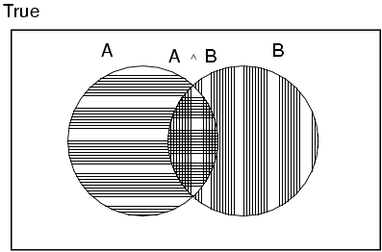
Axioms of probability
For any probability
0 ≤ P(A) ≤ 1
P(true) = 1 and P(false) = 0
P(A ∨ B) = P(A) + P(B) - P(A ∧ B) positions A, B
CS 470/670 Artificial Intelligence

Slide 17
Prior probability
Prior or unconditional probabilities of propositions
Joint probability distribution for a set of random variables gives the probability of every atomic event on those random variables
Cavity = true 0.144 0.02 0.016 0.02
Cavity = false 0.576 0.08 0.064 0.08
Every question about a domain can be answered by the joint distribution
P(Weather,Cavity) = a 4 × 2 matrix of values:
Weather = sunny rainy cloudy snow
e.g., P(Cavity = true) = 0.1 and P(Weather = sunny) = 0.72 correspond to belief prior to arrival of any (new) evidence
Probability distribution gives values for all possible assignments:
P(Weather) = <0.72,0.1,0.08,0.1> (normalized, i.e., sums to 1)
CS 470/670 Artificial Intelligence

Slide 18
Conditional probability
Conditional or posterior probabilities
This kind of inference, sanctioned by domain knowledge, is crucial
e.g., P(cavity | toothache) = 0.8
i.e., given that toothache is all I know
If we know more, e.g., cavity is also given, then we have
P(cavity | toothache,cavity) = 1
New evidence may be irrelevant, allowing simplification, e.g.,
P(cavity | toothache, sunny) = P(cavity | toothache) = 0.8
CS 470/670 Artificial Intelligence

Slide 19
Conditional probability
Definition of conditional probability:
Chain rule is derived by successive application of product rule:
  = P(X₁,...,X_{n-2}) P(X_{n-1} | X₁,...,X_{n-2}) P(X_{n} | X₁,...,X_{n-1})
  = …
P(X1, …,Xn) = P(X1,...,Xn-1) P(Xn | X1,...,Xn-1)
P(a | b) = P(a  b) / P(b) if P(b) > 0
Product rule gives an alternative formulation:
P(a  b) = P(a | b) P(b) = P(b | a) P(a)
A general version holds for whole distributions, e.g.,
P(Weather,Cavity) = P(Weather | Cavity) P(Cavity)
CS 470/670 Artificial Intelligence
Notes:
We can extend this for 3 variables:
P(A,B,C)=P(A|B,C)P(B,C)=P(A|B,C)P(B|C)P(C)
And in general to n variables
P(A1, A2, …,An)=P(A1|A2,…,An)P(A2|A3…,An)…P(An-1|An)P(An)

Slide 20

Inference by enumeration
Start with the joint probability distribution:
For any proposition φ, sum the atomic events where it is true: P(φ) = Σ_{ω:ω╞φ} P(ω)
Catch: the dentist’s steel probe catches in my tooth.
CS 470/670 Artificial Intelligence

Slide 21

Inference by enumeration
Start with the joint probability distribution:
For any proposition φ, sum the atomic events where it is true: P(φ) = Σ_{ω:ω╞φ} P(ω)
P(toothache) = 0.108 + 0.012 + 0.016 + 0.064 = 0.2
CS 470/670 Artificial Intelligence
Notes:
Given the full joint distribution to work with, ENUMERATE-JOINT-ASK is a complete algorithm for answering probabilistic queries for discrete variables.
It does not scale well, however: for a domain described by n Boolean variables, it requires an input table of size O(2^{n}) and takes O(2^{n}) to process the table.
In a realistic problem, there might be hundreds or thousands of random variables to consider, not just three. It quickly becomes completely impractical to define the vast numbers of probabilities required—the experience needed in order to estimate each of the table entries separately simply cannot exist.

Slide 22

Inference by enumeration
Start with the joint probability distribution:
Can also compute conditional probabilities:
P(toothache)
= 0.016+0.064
0.108 + 0.012 + 0.016 + 0.064
= 0.4
P(➢cavity | toothache) = P(➢cavity  toothache)
CS 470/670 Artificial Intelligence

Slide 23
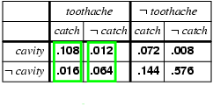
Normalization
This is a bold P!
Denominator can be viewed as a normalization constant α
  = α, [P(Cavity,toothache,catch) + P(Cavity,toothache,¬ catch)]
  = α, [<0.108,0.016> + <0.012,0.064>]
  = α, <0.12,0.08> = <0.6,0.4>
General idea: compute distribution on query variable by fixing evidence variables and summing over hidden variables
  Note that α = 1/P(toothache) and 0.6 + 0.4 =1
P(Cavity | toothache) = α, P(Cavity,toothache)
CS 470/670 Artificial Intelligence

Slide 24
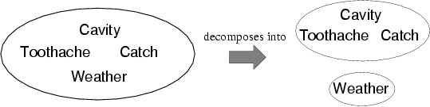
Independence
A and B are independent iff
P(A|B) = P(A) or P(B|A) = P(B) or P(A, B) = P(A) P(B)
  P(Toothache, Catch, Cavity, Weather)
  = P(Toothache, Catch, Cavity) P(Weather)
CS 470/670 Artificial Intelligence
Notes:
Independence assertions are usually based on knowledge of the domain. As we have seen, they can dramatically reduce the amount of information necessary to specify the full joint distribution.
Even independent subsets can be quite large---for example, dentistry might involve dozens of diseases and hundreds of symptoms, all of which are interrelated. To handle such problems, we will need more subtle methods than the straightforward concept of independence.

Slide 25
Bayes' Rule
Product rule P(a∧b) = P(a | b) P(b) = P(b | a) P(a)
⇒ Bayes' rule: P(a | b) = P(b | a) P(a)
P(b)
Bayes’ rule underlies all modern AI systems for probabilistic inference.
CS 470/670 Artificial Intelligence

Slide 26
Applying Bayes’ rule: The simple case
Useful for assessing diagnostic probability from causal probability:
P(Cause|Effect) = P(Effect|Cause) P(Cause) / P(Effect)
E.g., let M be meningitis, S be stiff neck:
P(m|s) = P(s|m) P(m) / P(s) = 0.8 × 0.0001 / 0.1 = 0.0008
Note: posterior probability of meningitis still very small!
CS 470/670 Artificial Intelligence
Notes:
posterior = likelihood * prior / marginal likelihood
P(R=r | e) = P(e | R=r) P(R=r) / P(e)
where P(R=r|e) denotes the probability that random variable R has value r given evidence e. The denominator is just a normalizing constant that ensures the posterior adds up to 1; it can be computed by summing up the numerator over all possible values of R, i.e., P(e) = P(R=0, e) + P(R=1, e) + ... = sum_r P(e | R=r) P(R=r) This is called the marginal likelihood (since we marginalize out over R), and gives the prior probability of the evidence.

Slide 27
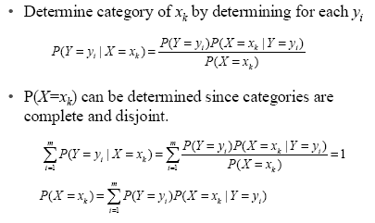
Bayesian Categorization
CS 470/670 Artificial Intelligence
Notes:
Let y be the random variable for the class which takes values {y1, y2, …,ym).
For classification, we need to compute P(y=yi|x=xk).

Slide 28
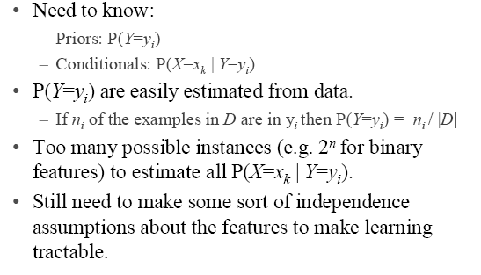
Bayesian Categorization
CS 470/670 Artificial Intelligence
Notes:
Let y be the random variable for the class which takes values {y1, y2, …,ym).
For classification, we need to compute P(y=yi|x=xk).

Slide 29
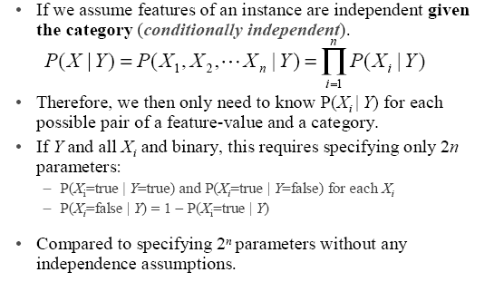
Naïve Bayes Generative Model
CS 470/670 Artificial Intelligence

Slide 30
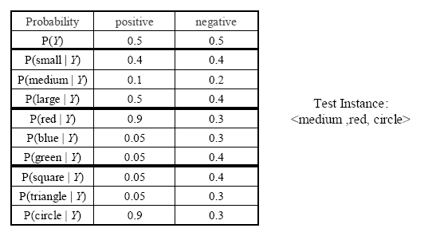
Naïve Bayes Example
CS 470/670 Artificial Intelligence

Slide 31
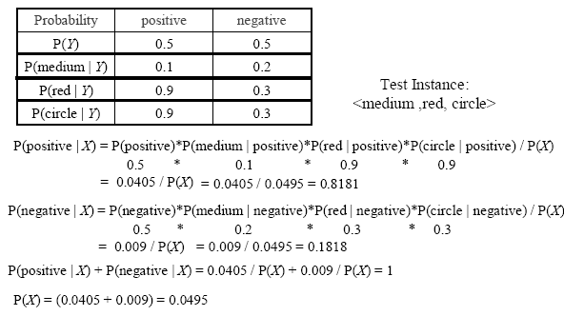
Naïve Bayes Example
CS 470/670 Artificial Intelligence

Slide 32
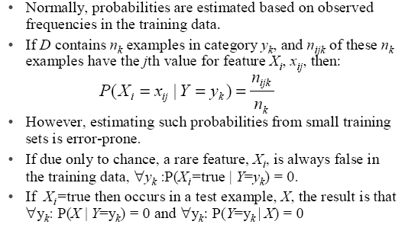
Estimating Probabilities
CS 470/670 Artificial Intelligence

Slide 33
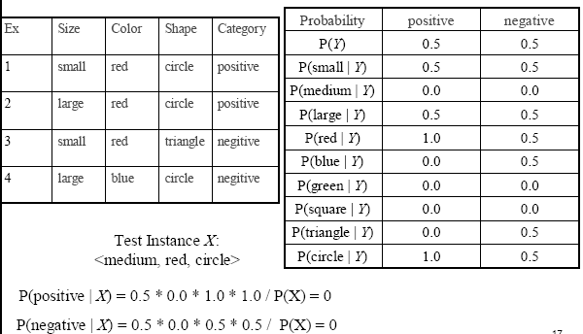
Probability Estimation Example
CS 470/670 Artificial Intelligence

Slide 34
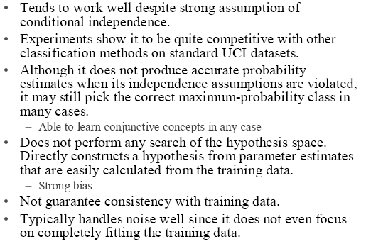
Comments on Naïve Bayes
CS 470/670 Artificial Intelligence
Notes:
In class exercise:
http://www.inf.u-szeged.hu/~ormandi/teaching/mi2/02-naiveBayes-example.pdf

